Slide 1
4.1 Emergency Management for SWDs
Tamara Mariotti
Coordinator of Accessibility Resources
Mohawk Valley Community College

Slide 2
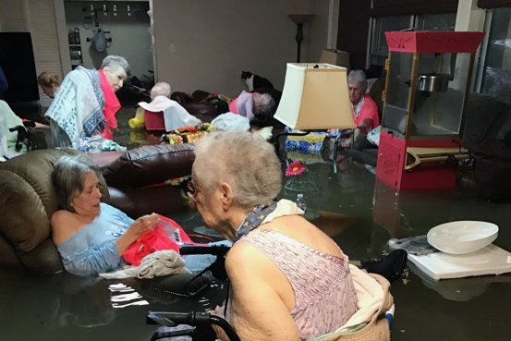
Objectives of this Emergency Management Presentation
Provide Disability Service Support staff with tools for emergency preparedness with regards to students with disabilities
Provide ideas for disability inclusion into institution emergency planning
Promote accessible communication and notifications for students with disabilities registered with our office.
Promote ideas for safety through training and exercises on your campuses.

Slide 3
Federal responsibility

Slide 4
Federal Laws Prohibiting Discrimination in Emergency Programs on the Basis of Disability
Americans with Disabilities Act of 1990
Stafford Act of 1988
Post Katrina Emergency Management Reform Act of 2006
Rehabilitation Act of 1973
Fair Housing Act Amendments of 1988
Architectural Barriers Act of 1968
Individuals with Disabilities Education Act (EHA) of 1975
Telecommunications Act of 1996
Twenty-first Century Communications and Video Accessibility Act of 2010

Slide 5
The 2006 Post-Katrina Emergency Management Reform Act (PKEMRA) directed FEMA to:
Establish a Disability Coordinator and develop accommodation guidelines;
Add provisions to the non-discrimination list for relief and assistance activities;
Coordinate and support evacuation and recovery efforts;
Provide transportation assistance;
Provide rescue, care, shelter, and essential needs assistance to individuals with service animals;
Provide case management assistance
Receive input

Slide 6
Key Principles of Emergency Management for People with Disabilities
Equal Access – People with disabilities must be able to access the same programs and services as the general population. Access may include modifications to programs, policies, procedures, architecture, equipment, services, supplies, and communication methods.
Physical Access – People with disabilities must be able to access locations where emergency programs and services are provided.
Access to Effective Communication – People with disabilities must be given the same information provided to the general population using methods that are understandable and timely.

Slide 7
Key Principles Continued
Inclusion – People with disabilities have the right to participate in and receive the benefits of emergency programs, services, and activities provided by governments, private businesses, and nonprofit organizations.
Integration - Emergency programs, services, and activities typically must be provided in an integrated setting.
Program Modifications - People with disabilities must have equal access to emergency programs and services, which may entail modifications to rules, policies, practices, and procedures.
No Charge - People with disabilities may not be charged to cover the costs of measures necessary to ensure equal access and nondiscriminatory treatment.

Slide 8
Is your campus considered a Disaster evacuation space for your community?

Slide 9
College responsibility
Emergency Preparedness is the shared responsibility of the whole college community

Slide 10
Colleges: Office of Disability Integration and Coordination of Emergency Preparedness
Responsible for ensuring that the access and functional needs and requirements of individuals with disabilities are being properly included and addressed in all aspects of emergency preparedness and disaster response, recovery, and mitigation.
Personal Emergency Planning – individualized plans
Where are Emergency phones and Area of Rescue located on your campus - Maps and website information
Emergency Alerts to students/staff –Text, voice, and email alerts – How do students register for alerts, and is it accessible to Blind, Hearing impaired, cognitive, physical needs?
Preparation and Training -Classroom emergency information, campus-wide emergency information.

Slide 11
Personal Medical Emergency Plan (PMEP)
Although the process of developing a Personal Medical Emergency Plan (PMEP) is optional for students and staff, the college encourages proactive planning on the part of the entire college community for emergency conditions. Individuals with disabilities may require additional assistance with alerting, evacuating, and sheltering in the event of an emergency.
Does your College offer the opportunity, through a confidential process, to develop a PMEP?
PMEP may include:
Strategies as storing extra equipment or medications,
Provides Public Safety and/or health center with a personal schedule,
Specific evacuation procedures, sheltering procedures, volunteer rescue assistants, using an optional Personal GPS Locator, and designating means of communication in the event of an emergency?

Slide 12
Personal Medical Emergency Plans
In addition to submitting a Personal Medical Emergency Plan (PMEP), any employee or student needing assistance is encouraged to share information with several reliable people in their classes, residence hall or work area about his/her need for assistance during an emergency. It is useful to name your volunteer rescue assistants in your Personal Medical Emergency Plan (PMEP) so that Public Safety and others can more easily contact them in an emergency.
Classroom health-related emergency information: Have a procedure that states how instructors should handle health-related emergencies in the classroom. It is particularly helpful to explain the steps instructors should take when a student has a seizure in class. This procedure should be created in collaboration with campus safety officials.
[File of MVCC Personal Medical Emergency Plan as an example]

Slide 13
Information has to be accessible to be actionable
Where do you have information located for community members, parents, or students that wish not to register with your office?
Website….. https://www.mvcc.edu/accessibility-resources/physical-accessibility

Slide 14
Disability related maps and way-finding of the campus
Maps should note important resources for students, faculty, and people with disabilities coming to campus.
Special Resources may include:
Directions/Routes to parking
Emergency Phones
Door Openers
Accessible Parking
Accessible Bathrooms
Elevators/times available
Areas of Refuge/Rescue
ATMs
Accessible Kiosks
DSS offices
Examples: https://www.pcc.edu/disability-services/community/wayfinding/

Slide 15
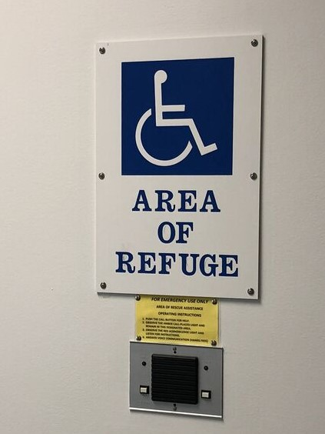
Areas of Refuge vs. Areas of Rescue
Areas of "Rescue Assistance“ and “Areas of Refuge” apply to other than ground level floors of all buildings on the Campus with more than one story above and/or below grade with an elevator.
The "Areas of Refuge" or "Areas of Rescue Assistance" concept was established to provide a location for building occupants, who cannot traverse the stairs without assistance, to be able to assemble by an exit and await assistance or instructions by the first responders.
Areas of Refuge requires a two-way communication system. This is also required in New Construction, Significant Remodels or Change of Building Use.
http://www.area-of-refuge.com/functionality.html

Slide 16
Training materials for faculty and staff
Fire Safety
http://www.mingerfoundation.org/projects/fire-safety-info/videos/
https://www.nfpa.org/Public-Education/By-topic/People-at-risk/People-with-disabilities
FEMA, RED CROSS, Homeland Security
[Pamphlets provided as handouts]
https://www.mvcc.edu/accessibility-resources/faculty-staff-resources

Slide 17
EXERCISES & EVACUATION
Whole community practice for disasters
People with a variety of disabilities must be included (Actors should not be used) People with disabilities should pose real life challenges
Campus-wide emergency information: Be prepared for students, parents, faculty and staff to ask how they receive notification of an emergency whether it is a snow closing, tornado, bomb threat or violent or terrorist incident. It is imperative that as campuses wrestle with these issues that they remember to include individuals with disabilities in their planning and execution. It is also important that not all the planning be reactive—proactive or preventative action needs to be implemented also.
[Table top exercises]

Slide 18
The Words We Use
The difference between the right word and the almost right word is the difference between lightning and a lightning bug. Mark Twain
We hear it all the time – ‘special needs’ and ‘vulnerable.’ Both terms do damage. When people with disabilities are thought of as ‘special,’ they are often thought of as marginal individuals who have needs, not rights. The word ‘vulnerable’ has a similarly unfortunate effect. Vulnerable people must have things done for them; they’re recipients, not participants. -CT Protection & Advocacy Agency FEMA

