Slide 1
ONONDAGA PATHWAYS TO CAREERS (OPC)
Office of Disability Employment Policy, U.S. Department of Labor project at Onondaga Community College

Slide 2
What is Onondaga Pathways to Careers?
The Onondaga Pathways to Careers (OPC) project is a federally-funded, capacity-building educational and workforce project of Onondaga Community College in Syracuse, New York.
The OPC project aims to prepare youths and young adults with disabilities (ages 14 to 24) to enter 21st century, high-demand, skilled, and living wage careers in Central New York (CNY).

Slide 3
What academic programs fall into OPC?
Advanced Manufacturing (Certificate)
Mechanical Technology (AAS)
Electrical Technology (AAS)
Computer Information Systems (AAS)
Computer Science (AS)
Computer Forensics (AS)
Electronic Media Communications (AAS)
Health Information Technology (AAS)
Hospitality Management (AAS)
Some others as well..

Slide 4
Career Goals for OPC Students
Increase career and self-awareness
Develop job search skills
Create career goals
Build awareness and knowledge of the chosen career fields
Develop Employability and Soft Skills
Leadership Skills
Gain exposure and experience through work based learning opportunities

Slide 5
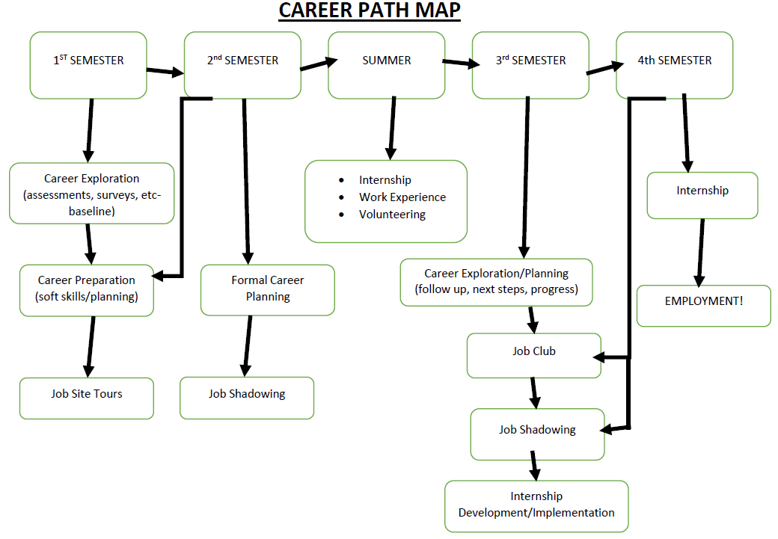

Slide 6
Career Exploration
Assessments
Career Coach, Holland’s Assessment, Mynextmove.org (O*Net)
Surveys
Career Research
Guest Speakers/Business Presentations
Informational Interviewing

Slide 7
Career Planning
Resume Development- Purple Briefcase
Cover Letter Prep
Application Process Review
Job Search Process/Job Lead Research
Interview Skill Training/Mock Interviewing- Interview Stream Software

Slide 8
Career Preparation (Soft Skills)
Communication Skills
Decision Making
Leadership/Team Work
Motivation/Work Ethic
Problem Solving
Time Management
Employability Skills Assessment
Learning Resources Incorporated (LRI) is a soft skills test which measures those skills required for employees to be ready to work successfully

Slide 9
Job Site Tours
General overview of business/observe work in progress
Ability to see different types of work
Chance for Q & A with management

Slide 10
Job Shadowing
Set schedule, repeat visits (if possible)
Observe specific job functions
Highlight skills used on the job
Arrange for hands-on experience

Slide 11
Service Learning/ Volunteering
Provides hands on exploration of goals and skills
Aids in developing contacts/references
Enriches resume

Slide 12
Internship
Ongoing, structured exposure of and experience in a field of interest
Opportunity to develop, practice and demonstrate new skills and obtain occupational knowledge

Slide 13
Job Club
Groups meet on a scheduled basis to discuss areas of interest (each major can have a club)
Discuss job leads, placement resources, prep for interviews, peer feedback

Slide 14
Ways We Engage Students in Career Development
Provide multiple opportunities to build and practice skills
One-on-One (Advising/Counseling)
Group Sessions (In class, learning communities, workshops, seminars)
Work-based learning

Slide 15
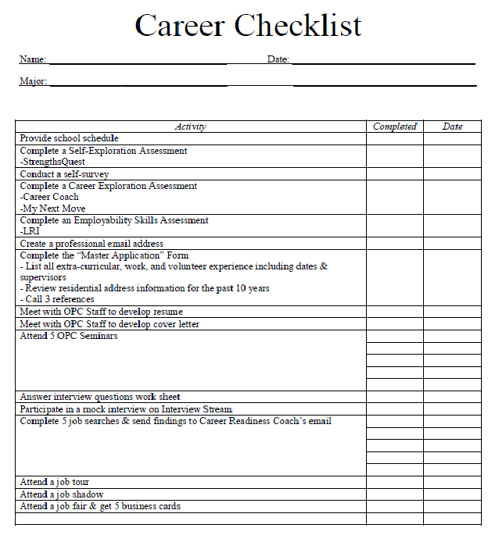

Slide 16
Employer Engagement
Collaborating with OCC’s Economic and Workforce Development staff to complete employer outreach.
Invite employers to participate in program activities at various levels of engagement:
Hosting a student for paid/unpaid work experiences
Offering site visits
Job-shadowing days
Acting as a guest speaker or trainer
Serving on a youth advisory board

Slide 17
Employer Engagement
Offer disability awareness information, training assistance (TA), such as “Brown Bag Sessions” for staff
Conduct regular follow-ups/check-ins with both employer and employee to ensure that standards are being met
Offer assistance with reasonable accommodations

Slide 18
Employer Engagement
Accommodations may include:
Allowing extended breaks during the workday
Making facilities accessible
Changing a workstation arrangement
Altering lighting in an office space
Assigning quieter office space with less traffic
Modifying, or making available, equipment or devices
Offering qualified readers and sign language interpreters
Allowing job coach participation
Permitting part-time or modified work schedules
Color-coding files
Keeping written

Slide 19
Questions?
Please feel free to contact me via email or telephone at:
m.t.horan@sunyocc.edu
315-498-2857
Onondaga Pathways to Careers Website: http://www.sunyocc.edu/opc

Slide 20
Shifting gears:
Universal Design for Learning Academy

Slide 21
Another OPC goal is to enhance the campus climate and improve accessible instruction
Summer 2017 OCC offered the first Universal Design for Learning Summer Academy

Slide 22
Process:
There was a competitive application process
3 staff organized and ran the academy: Nancy Carr, William Myhill (OPC
Project Director) and Chris Hromalak (faculty member).
Applicants were selected and notified. They were given pre test and selected readings in preparation.
Year 1- 15 faculty were invited and attended from a range of academic departments

Slide 23
Phase 1 of the UDL Academy is a four day intensive workshop July 10-14th.
This will be repeated this year in the second UDL academy
Faculty are given a stipend of $1000.00 for completion of phase 1.
Fall semester is phase 2 of the UDL academy. Phase 2 consists of the faculty
Completing their project to implement UDL in a class or in another approved project. They must attend meetings and additional training sessions. They agree to become a UDL mentor in their department. They participate in a session to showcase their project. Upon completion of phase 2 they receive an additional stipend of $1000.00.

Slide 24
UDL Academy Year 2
This Summer 17 faculty and 7 professional staff will attend.

Slide 25
Universal Design for Learning Academy
Pretest:
● Conduct baseline survey of UDL awareness and knowledge (5 to 7 Qs), and assess basic UDL applied knowledge (5 to 7 Qs).
Prework:
● Brainstorm at least 2 courses or contexts where you could better support your students
● Register for an account at UDL Theory and Practice (http://udltheorypractice.cast.org/login) and read chapters 1 and 2.
● Browse the CAST: About UDL (http://www.udlcenter.org/aboutudl) and the CAST: About Universal Design for Learning (http://www.cast.org/our-work/about-udl.html) website in anticipation of the UDL Academy.
Monday, July 10th - Introductions / Choose Your Project
9am Introductions/What is Universal Design?/Overview of the Academy (C. Hromalik)
10am Disability Awareness / Etiquette (N. Carr)
11am Intersection of UDL with Higher Education Disability Legal Mandates (W. Myhill)
12pm Lunch break
1pm 2016 UDL Academy Faculty Panel
230pm Group work - Worksheet 1
Homework:
● Choose your project - Prepare to share your project with others
● Complete Worksheets 1-3
● Read through all worksheets in preparation for the rest of the workshop

Slide 26
Tuesday, July 11th - Analyze
9am Project work – Share project ideas
930am Accommodations (N. Carr)
1030am OPC Student Panel
12pm Lunch Break
1pm Analyze - Worksheets 2-3
130pm Group Work - Worksheets 2-3
Homework:
● Complete Worksheets 2-3 (if not already completed)
● Prepare to share your project with others
● Read UDL Preparatory Readings - How could each principle be applied to your instruction?
Wednesday, July 12th - Design
9am Group Work – Go over homework from yesterday
10am UDL 1 - Engagement (C. Hromalik? P. Voorhees?)
11am UDL 2 - Representation (C. Hromalik? P. Voorhees?)
12pm Lunch break
1pm UDL 3 - Action and Expression (C. Hromalik? P. Voorhees?)
2pm Design - Worksheets 4-7 (C. Hromalik)
Homework:
● Complete Worksheets 4-7
● Prepare to share your project with others
Thursday, July 13th - Develop, Implement, Evaluate… and Beyond
9am Project Work – Go over homework from yesterday
10am Accessible Web Resources (W. Myhill)
10am Assistive Technology and Online Instruction (N. Carr and L. Matechak)
1130pm Develop – Worksheets 8-9 (C. Hromalik)
1200pm Lunch break
100pm Project work – Worksheets 8-9
200pm Implement and Evaluate – Worksheet 10
215pm Your Next Steps (Finishing Your Project, Training Other Faculty)
300pm Wrap-up / Evaluation of Workshop / Post-test
Homework:
● Prepare your modified course for Fall 2017 implementation!
● Schedule a time to “meet” virtually with Chris to discuss your project

